Slide 1
Stock Market DASHBORD

Slide 2
SUMMARY OF THE DATA
📊 Dataset Overview:
Rows: Multiple entries (stocks)
Columns: 15 total, each representing key financial metrics for individual stocks.

Slide 3
🧾 Key Columns:
Market Cap (In Rs Cr.): Market capitalization in crores of rupees.
Current Price: Latest trading price.
Stock: Name of the company.
PE Ratio: Price-to-Earnings ratio.
52 Week High / Low: Highest and lowest price over the past year.
% Below 52 Week High / % Above 52 Week Low: Relative price performance.
Yesterday Closing Price: Closing price from the previous trading day.
% Change: Daily percentage change.
Industry: Sector the stock belongs to.
NSE/BSE: Ticker symbol or code.
Bear Mode1 / Bear Mode2: Indicators (Yes/No) for bearish signals.
Stock Status: Label like "Good Stock".
Cap Size: Market cap classification (e.g., Large Cap).

Slide 4
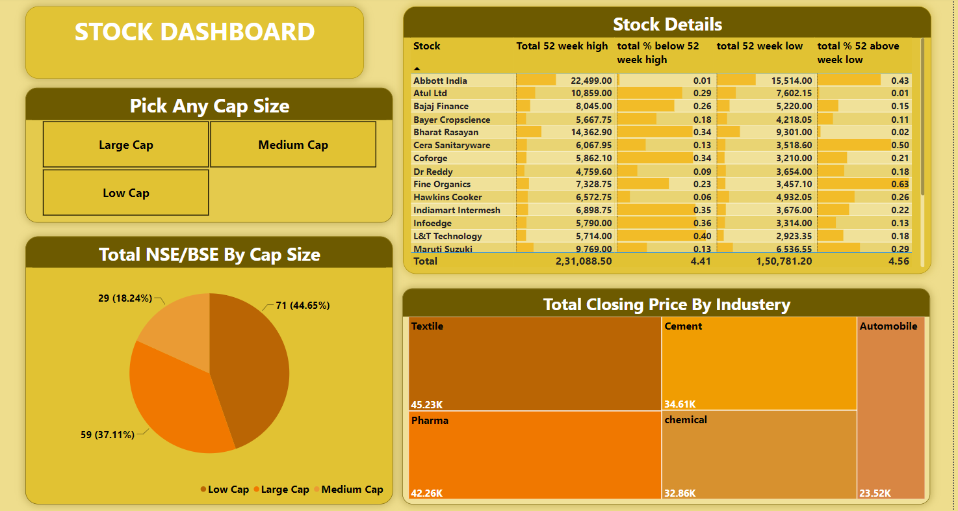
Dashboard

Slide 5
